Slide 1

Low-fi Prototyping &
Pilot Usability Testing

Slide 2
01 Our Mission
02 Interface Design
Overview
03 Prototype & tasks
04 Experiments
05 UI Changes + Summary

Slide 3
Our Mission

Slide 4
The current digital landscape leaves a lot to be desired for content creators and their fans.
Creators struggle to get meaningful input from their fans, and fans feel like they aren’t being heard.
Croissant creates digital studios to enable focused, productive collaboration with fans who want to contribute.

Slide 5
Interface Selection + Design

Slide 6
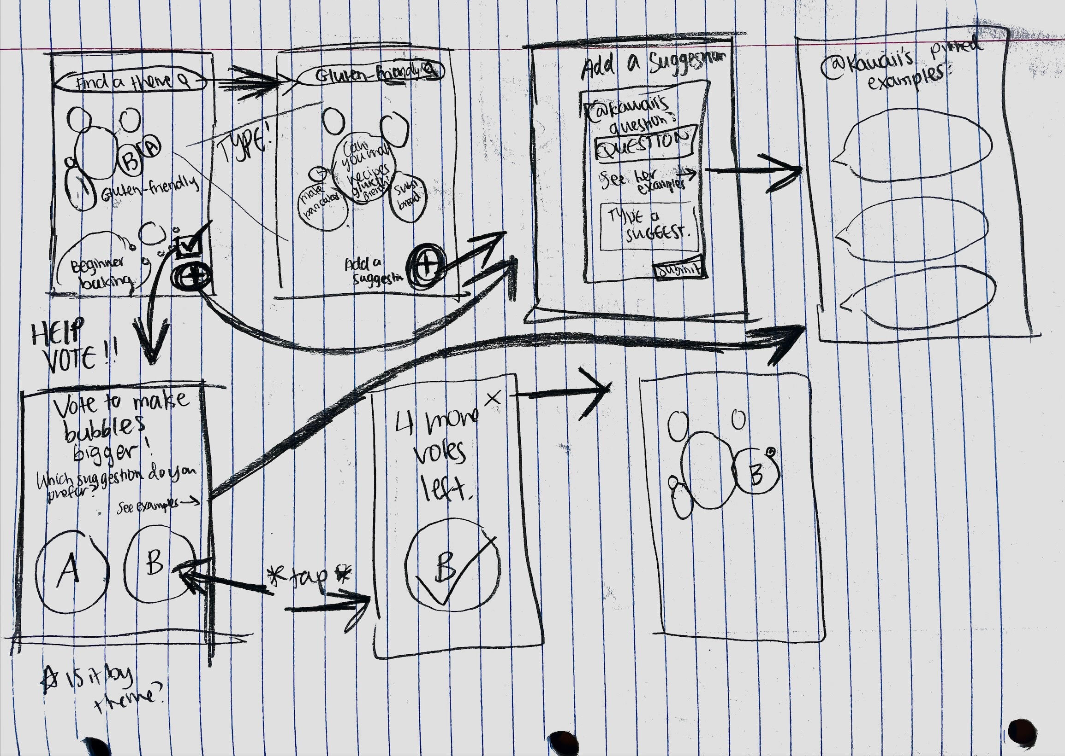
01
Comment Bubbles
02
Collaborative Studio

Slide 7
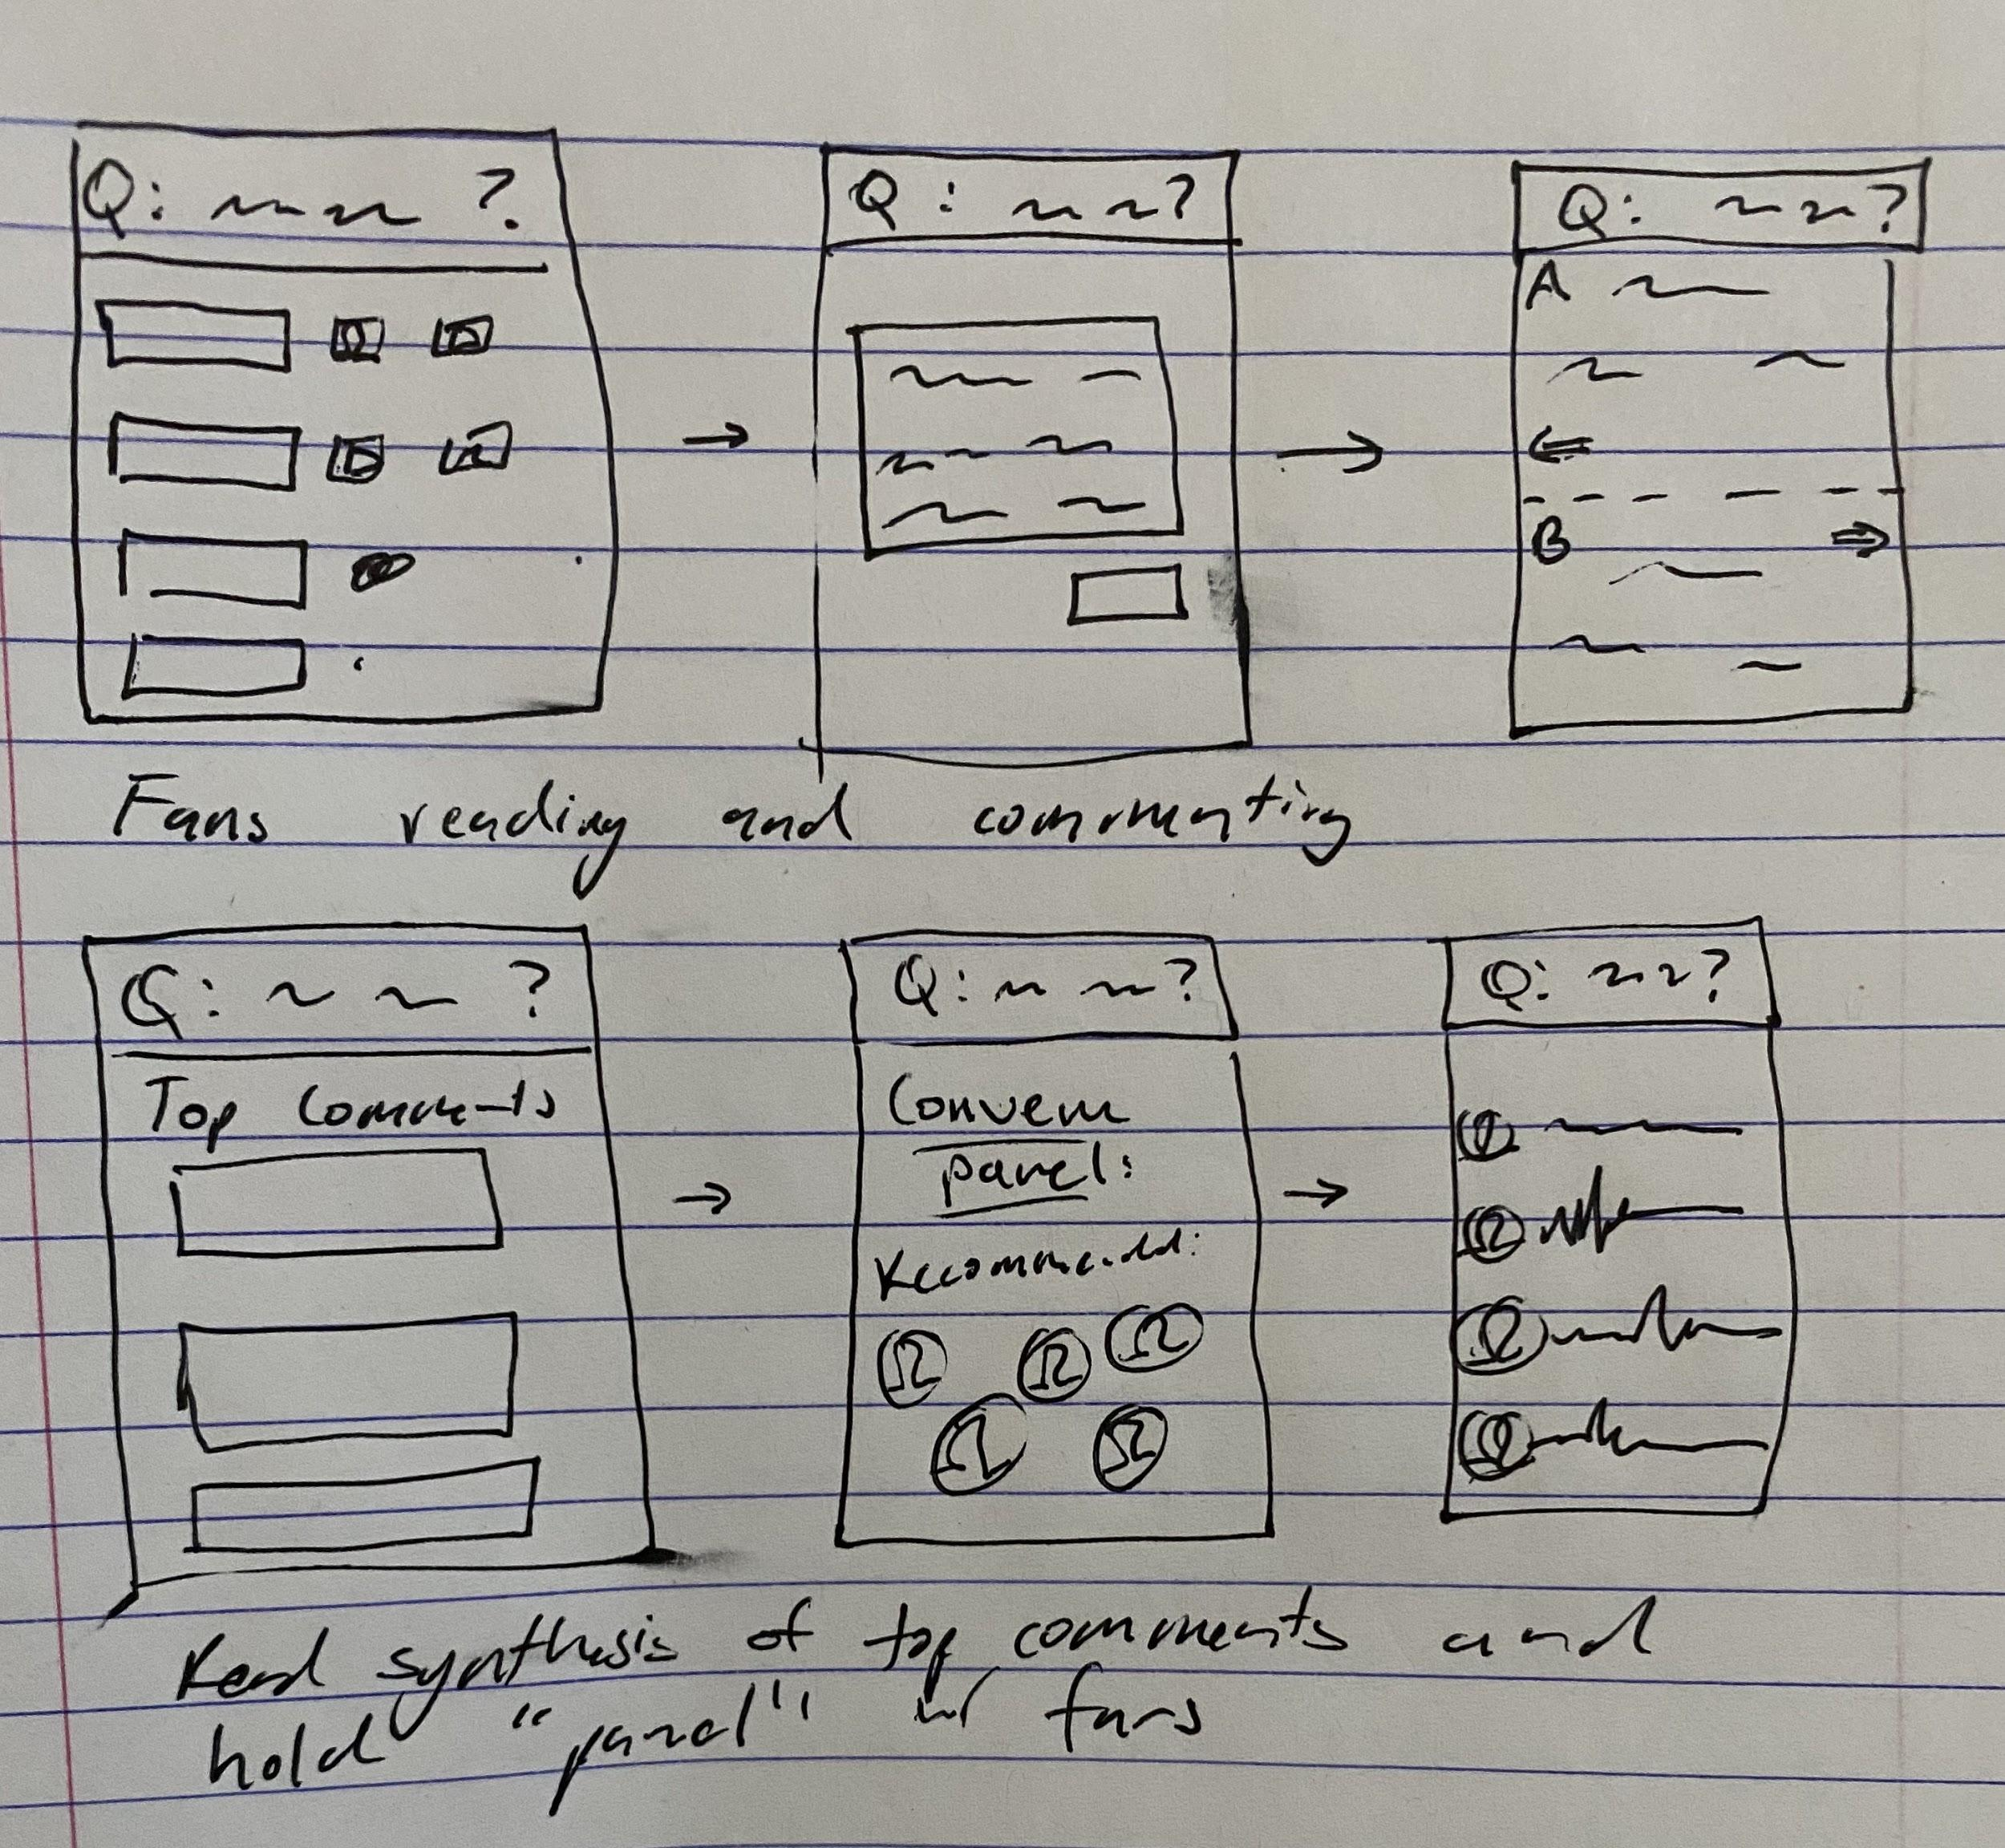
01
Comment Bubbles
02
Collaborative Studio

Slide 8
Interface Choice: Collaborative Studio
Decision making rationale:
Displaying comment bubbles of various size too chaotic for phone screen
Collaborative studio is intuitive and provides structure to guide fans along design process
Comment bubbles not conducive to constructive discussions, and might amplify existing issues with comments sections
Chose to continue with Collaborative Studio interface

Slide 9
Prototype
& Tasks

Slide 10
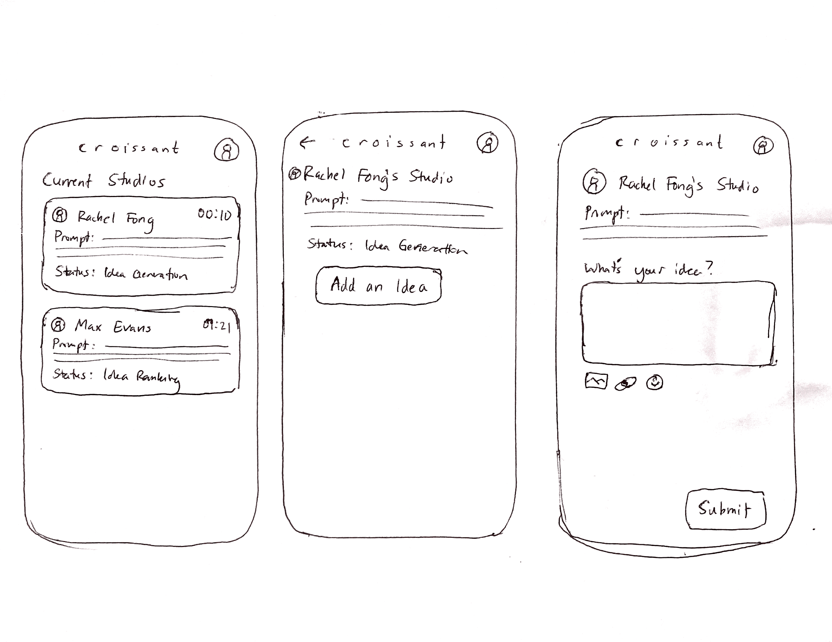
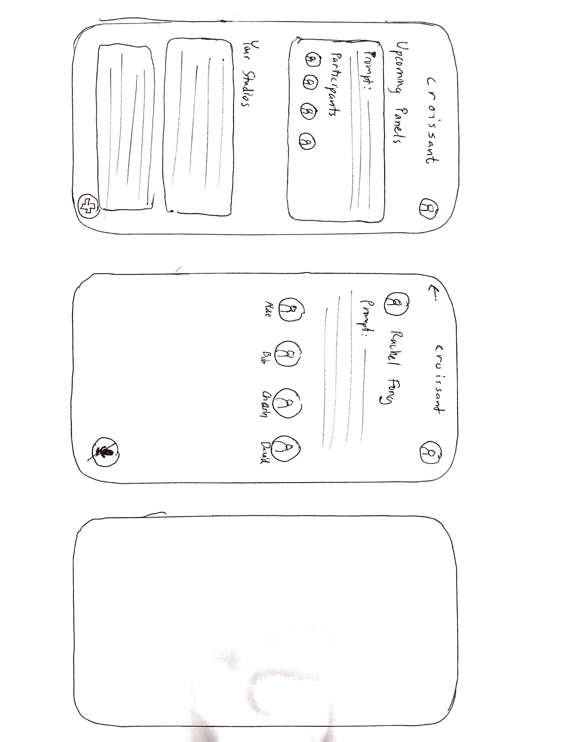
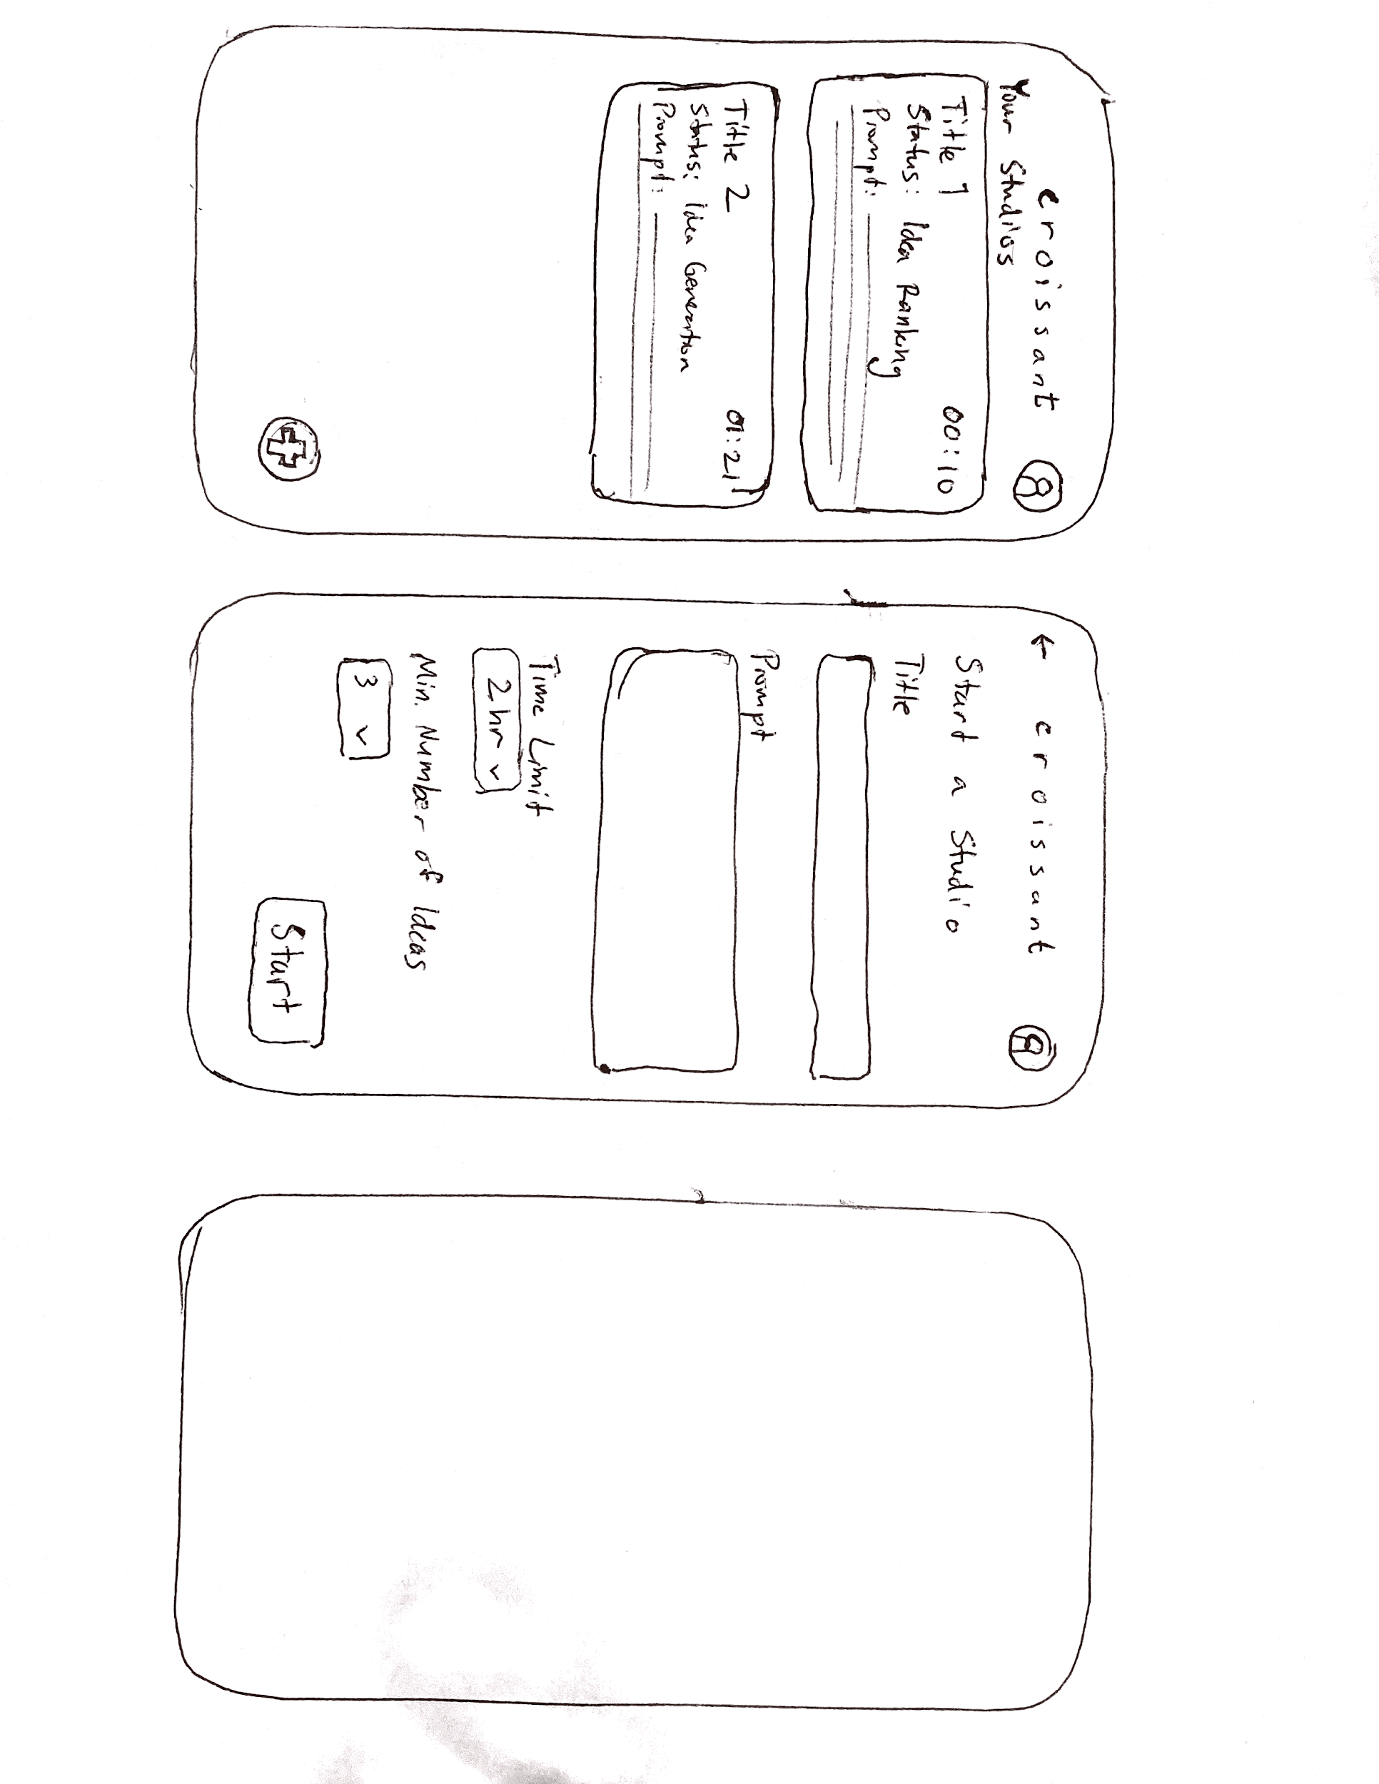
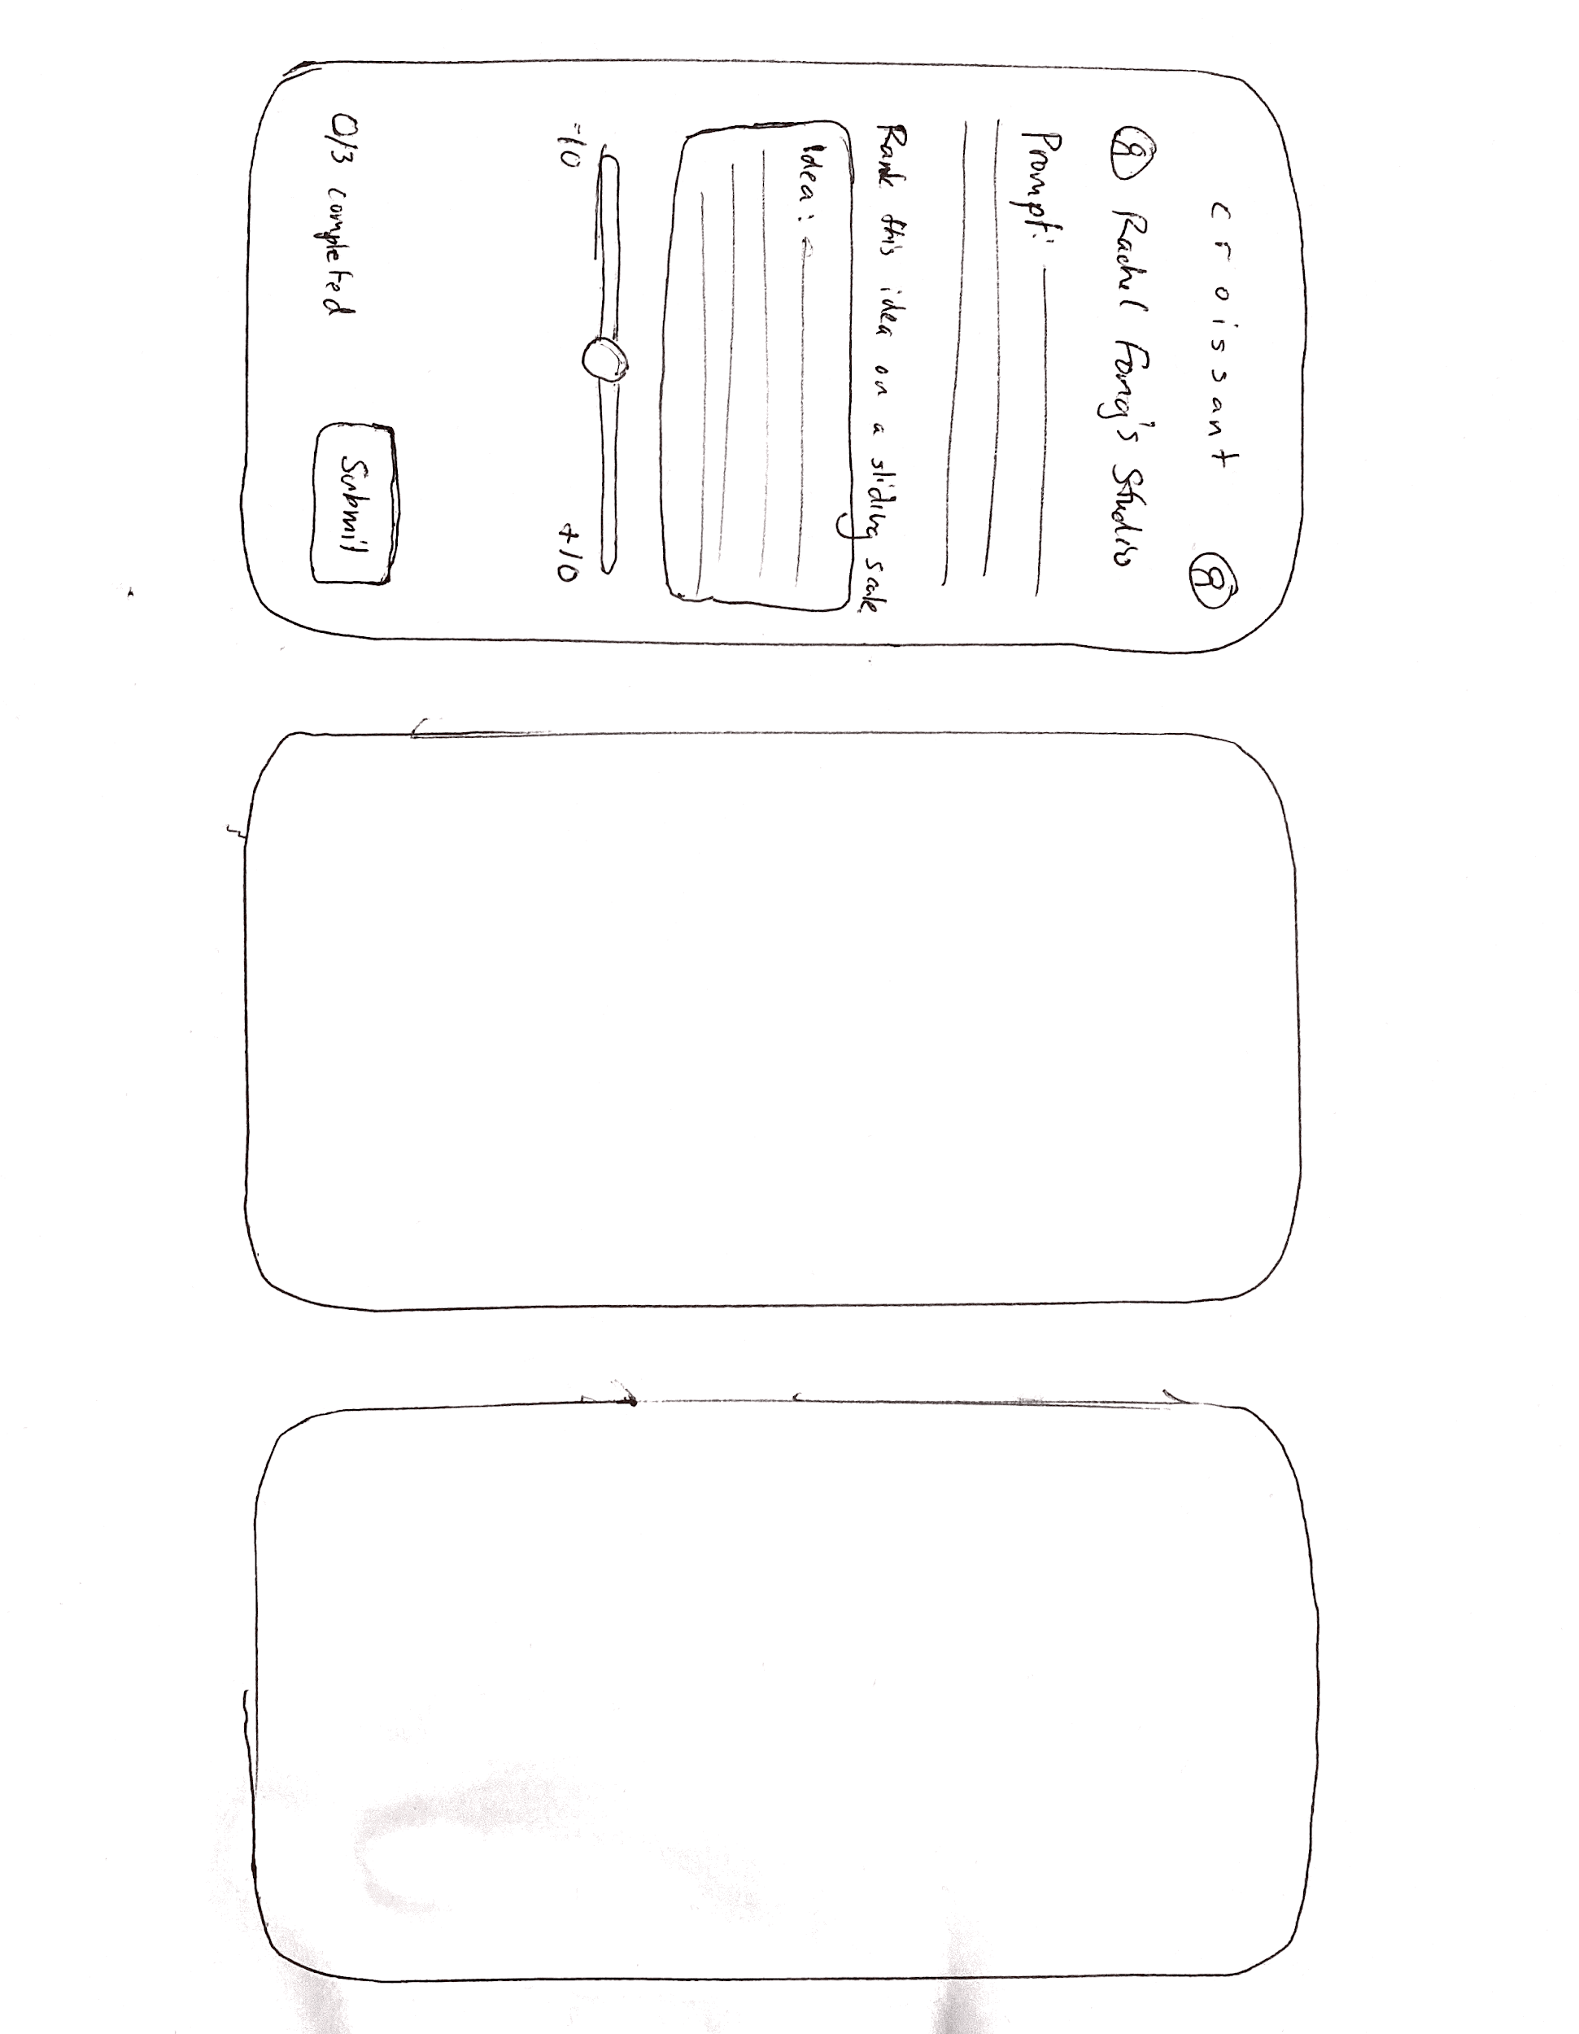
Prototype Overview
Each UI task maps to phase of brainstorming process
Posing a Question
Idea Generation
Prioritization/Ranking
Further Discussion
1 creator-specific task, 2 fan-specific task, 1 combination task

Slide 11
Task #1: Initialize a studio session (creator)

Slide 12
Task #2: Submit an idea (fan)

Slide 13
Task #3: Prioritize/rank an idea (fan)

Slide 14
Task #4: Join panel session with top collaborators (fan + creator)

Slide 15
Experiments

Slide 16
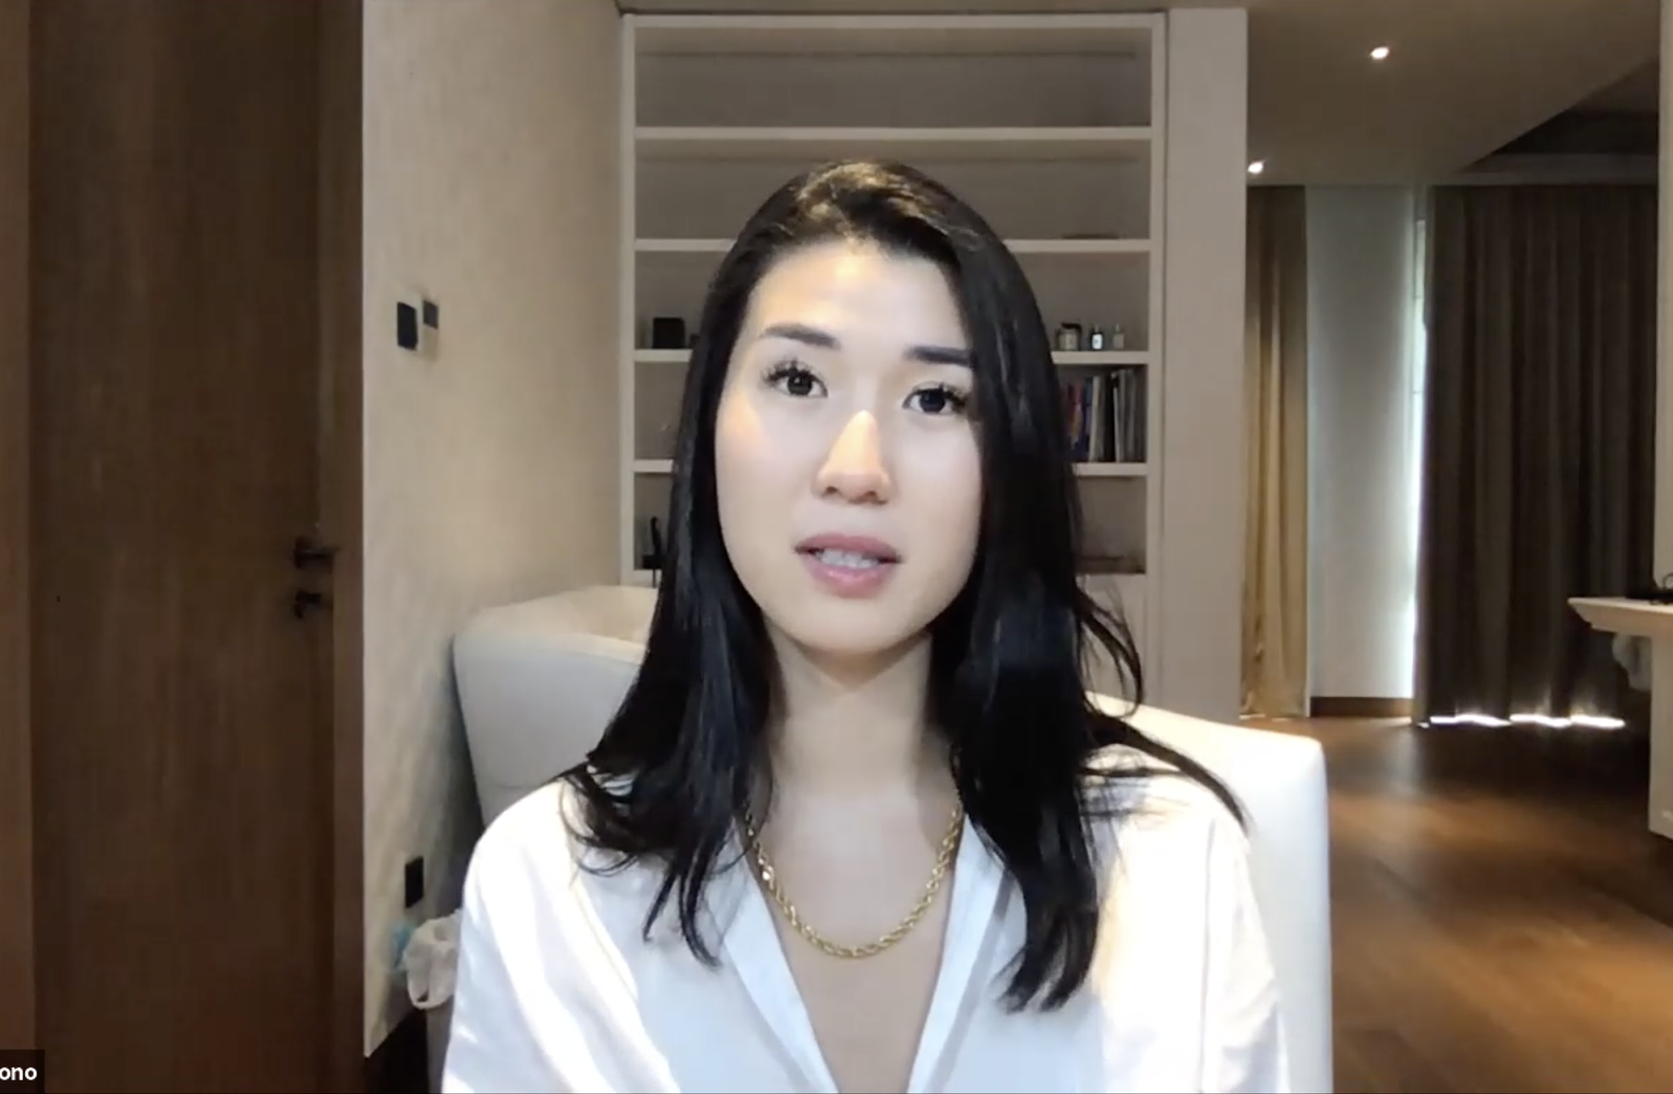
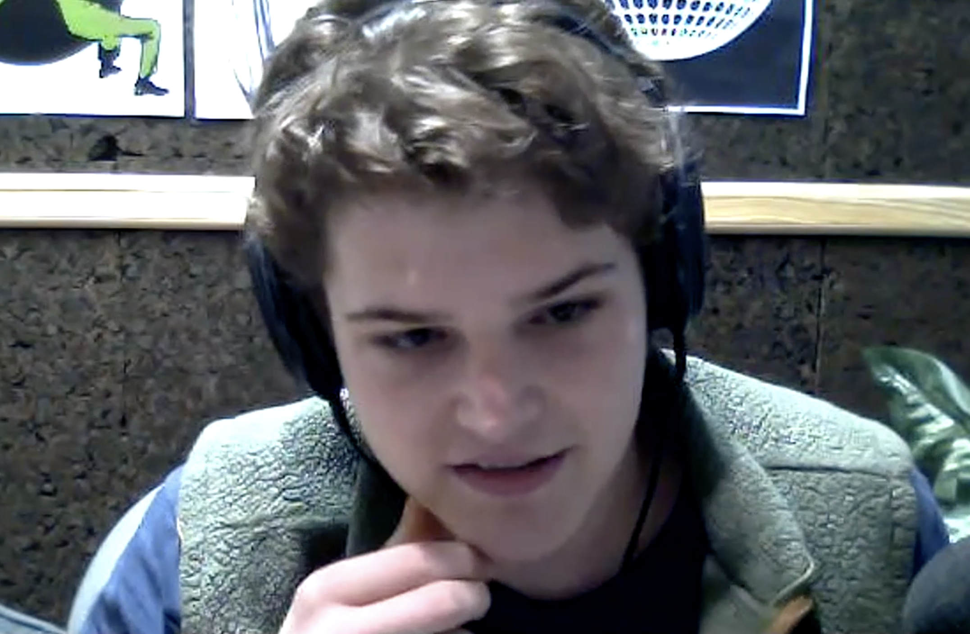
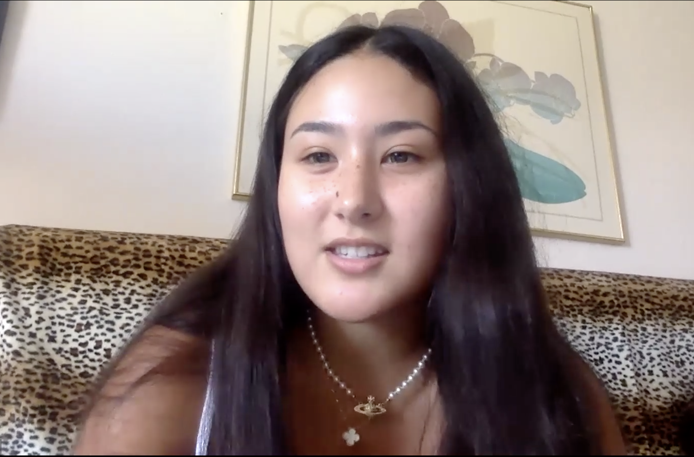
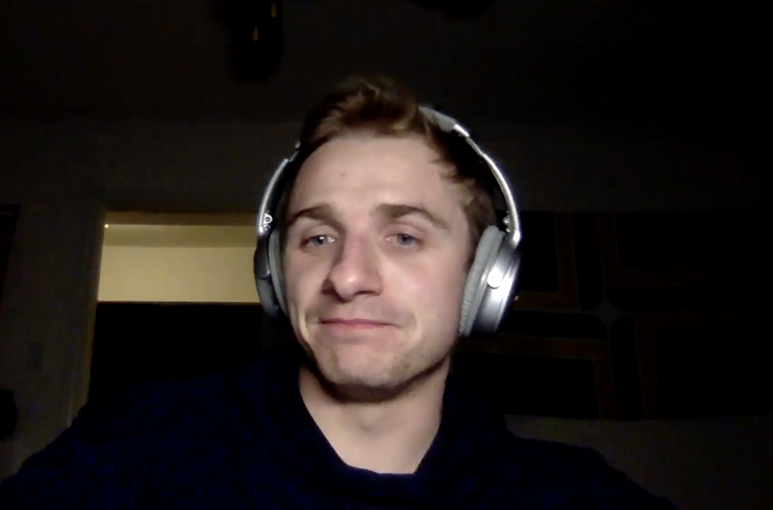
Participants
Christie
Lifestyle content Creator
dean
Niche content Creator
GIGI
Lifestyle content Fan
Adam
Niche content fan

Slide 17
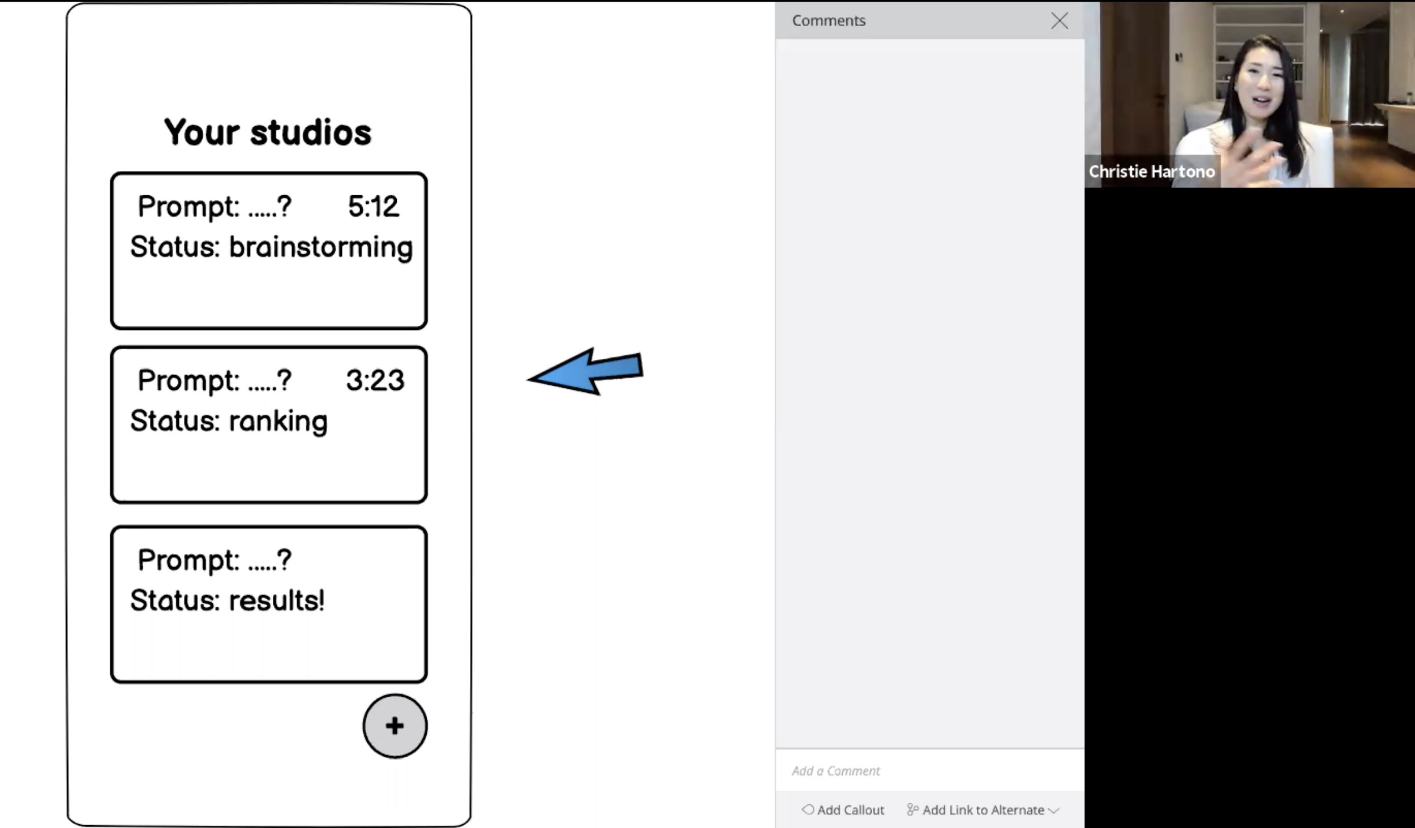
Experimental Methodology
Uploaded basic interface to Balsamiq and conducted all experiments via Zoom
One interviewer asked participant to navigate through tasks while other interviewer controlled Balsamiq
A/B tested ranking systems and format for live panels

Slide 18
Test Successes
Fans:
Easily navigated UI and performed all tasks
Validated ranked choice voting for choosing best ideas
Very excited about the potential for interaction with creator at the end of process
Creators:
Flows for creating a studio and hosting a panel were mainly intuitive
Liked the live panel format with audience

Slide 19
Design weak points
Fans:
Some resistance to making small panel discussions publically available
Loss of motivation to participate in studios if ideas are repeatedly not chosen
Creators:
Hesitant about answering certain types of questions (i.e. highly personal)
Open to democratic nature of platform, but would value some degree of credentials/expertise among fans

Slide 20
UI Changes
Summary

Slide 21
UI Changes
Problems
Fan questions cross boundaries
Separating expert feedback from uninformed criticism
Fan resistance to making public panel discussions
Loss of motivation to participate in studios if ideas are repeatedly not chosen
Solutions
Creators pin example comments
Fan comments displayed short bio tags
Allow users to opt into public/private panels
Recap screen thanking fans and giving them a quantitative assessment

Slide 22
Summary
Collaborative studio interface is intuitive to navigate for fans and creators
Small tweaks needed to keep both sides satisfied with in-platform interactions

